Slide 1
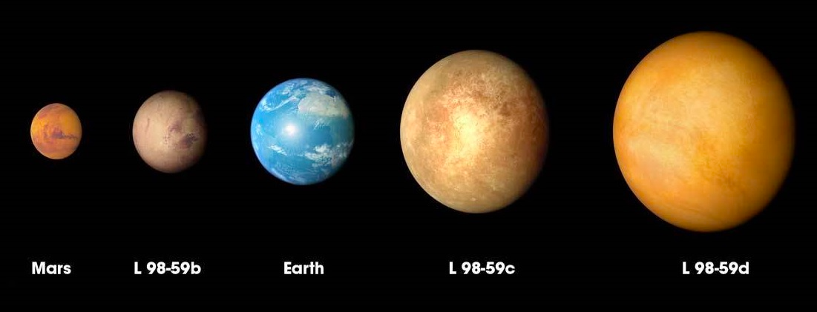
Lec 14: Exoplanets
© Gerard Williger 2023, U Louisville
Transits play a key role in detecting exoplanets
Permit LARGE NUMBERS of discoveries
Give crucial information about
Planet sizes
Planet distances from their stars
Planet atmospheres
Color details + features are artist conceptions!
Sizes of exoplanets in L98-59 star system, distance 35 light years (11 parsecs), discovered by NASA’s Transiting Exoplanet Survey Satellite (TESS), NASA Goddard Space Flight Ctr LINK ; includes 1.6’ VIDEO FYI
Notes:
A parsec is a distance of measurement used by astronomers, equal to 3.26 light years. It is the distance at which a rod of length one Astronomical Unit (distance from Earth to Sun) subtends one arcsecond.

Slide 2
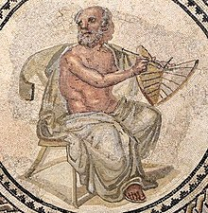
Ancient Ideas of Exoplanets
© Gerard Williger 2023, U Louisville
Anaximander, and later Leucippus, Democritus and Epicurus (spanning 6th – 3rd cent. BC) all “speculated on the plurality of worlds … that worlds appeared and disappeared for a while, and that some were born when others perished.” LINK-Wikipedia
Roman mosaic from Johanisstraße, Trier,Germany, Anaximander holding a sundial, dated to early 3rd cent. AD. Public domain, Wikipedia

Slide 3
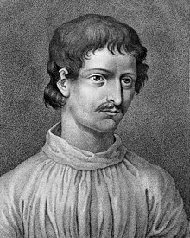
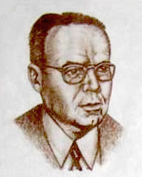
More Conjecture
© Gerard Williger 2023, U Louisville
Giordano Bruno: “stars are similar to the Sun and [have planets]” (16th cent.)
Sir Isaac Newton: “if the fixed stars are the centres of similar system, they will all be constructed according to a similar design…” (1687, Principia)
Otto Struve: wrote in 1952, “proposed Doppler spectroscopy and the transit method could detect super-Jupiters in short orbits” (quoted via Wikipedia)
Giordano Bruno (1548-1600), source LINK, Wellcome Trust
Otto Struve (1897-1963), USPS stamp 1949
Notes:
Bruno was burnt at the stake in Rome, not just for science views. See Wikipedia link for details.

Slide 4

Our Solar System from Nearest Star
© Gerard Williger 2023, U Louisville
Apparent Sun would be bright star, just fainter than Rigel in Orion’s shoulder
Jupiter
4 arcsec away = 4x thicker than a thick human hair at 2nd base viewed from home plate on a baseball diamond. (Full Moon is 30 arcmin = 1800 arcsec across.)
4 billion times fainter than apparent Sun! – lost in glare
Earth: 0.8 arcsec away, 1/10 trillionth as bright!
Most stars >100x farther!
Image LINK
If Sun were a grapefruit in Louisville, Earth would be a 1mm BB 11m (12 yds) away. Nearest star: grapefruit in Seattle WA!
Notes:
Our Voyager probes have gone about 15 football fields away in this analogy, after about 45 years of flight.

Slide 5

Exoplanets: Hard to Discover!
© Gerard Williger2023, U Louisville
Exoplanets only reflect small amount of their host-stars’ luminosities
−− extremely difficult to see directly – like a bug by a light
INDIRECT methods: look for
1) “Reflex Motions” of stars caused by an orbiting object
2) Shadows from transits
Both methods: require exoplanet’s orbit NEARLY EDGE-ON toward Solar System
Direct imaging: EVEN HARDER

Slide 6
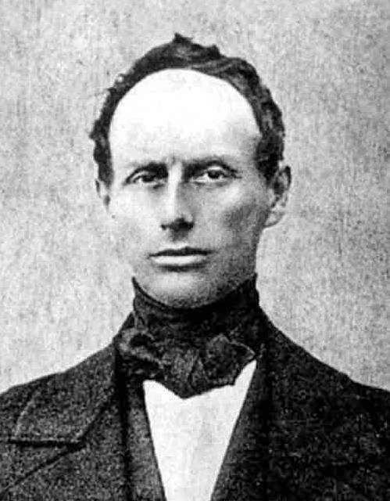
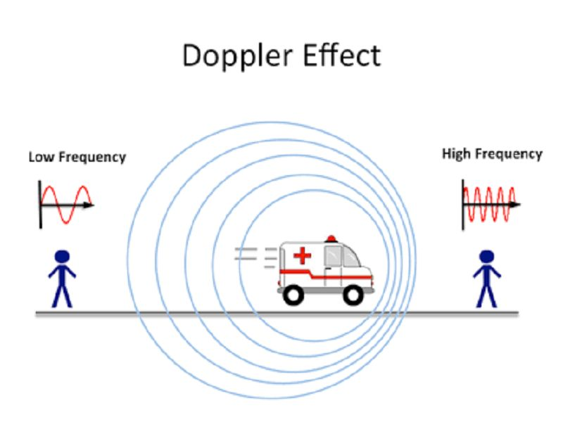
1) The Doppler Effect and Motion
© Gerard Williger2023, U Louisville
Doppler effect: rise/fall in frequency from motion along line of sight (Christian Doppler, 19th cent.)
Works for water, sound, light or ANY wave – including LIGHT
Christian Doppler (Austrian Empire, 1803-53), public domain LINK
We hear the Doppler effect for sound every time a siren passes us. 9” VIDEO
Lower frequency, longer wavelength
Higher frequency, shorter wavelength
Image source LINK

Slide 7
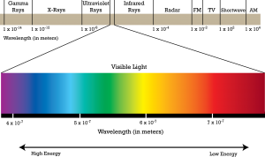
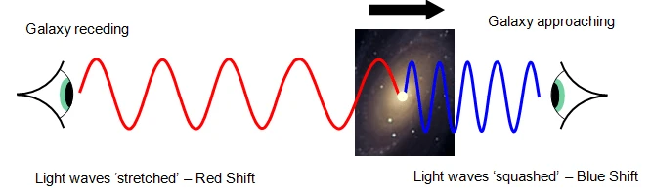
Doppler Shift for Light:
© Gerard Williger 2023, U Louisville
BLUE LIGHT: has relatively higher frequency, higher energy, shorter wavelength → “blueshift”
RED LIGHT: has relatively lower frequency, lower energy, longer wavelength → “redshift”
Image credit: www.pion.cz and blogs.ubc.ca
Image credit: https://www.tuttee.co/blog/phys-doppler-effect

Slide 8
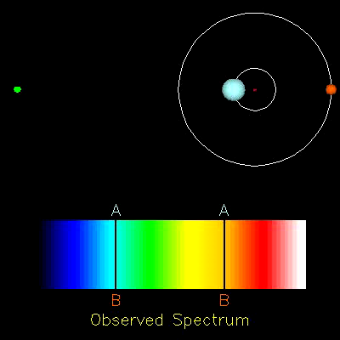
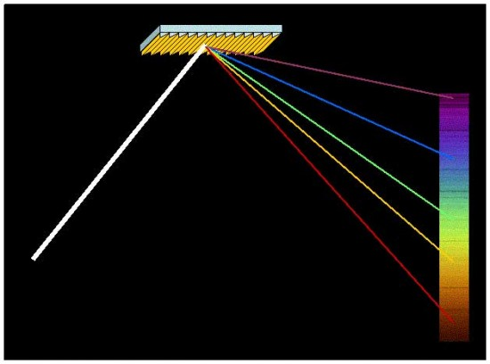
Example #1 - Doppler shifts
© Gerard Williger2023, U Louisville
Blueshift: comes TOWARD observer
Redshift: goes AWAY from observer
Detected with a spectrograph using a finely scored mirror to spread out light by color (“diffraction grating”) + lenses + camera
grating
Atoms of elements like calcium absorb certain wavelengths, leaving black lines in the “spectrum” (spread out light)
Over course of an orbit, line wavelengths change!
A grating acts similarly to a prism.
Incoming light from star, image LINK, NASA/JPL
1’ VIDEO FYI on spectroscopy

Slide 9
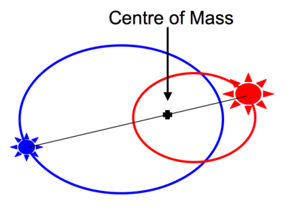
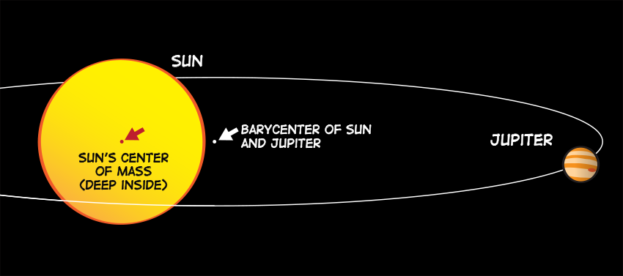
Example #2 for Doppler Shifts
© Gerard Williger 2023, U Louisville
Jupiter and the Sun pull on each other via gravity equally hard as they orbit -- every 12 years around their center of mass (“barycenter”) which is at 1.1 solar radii
Sun is 1000x more massive
so Sun accelerates 1000x less than Jupiter, makes an orbit 1000x smaller, moves 1000x slower
Jupiter orbits at 13 km/sec, so Sun orbits the Sun-Jupiter barycenter at 13 meters/sec
Earth is 300,000x less massive than Sun, orbits at 30 km/sec
Sun orbits Sun-Earth barycenter at 10 cm/sec
Image: Swinburne U., Australia
1.7’ VIDEO FYI on radial velocities
Image: NASA
Not to scale!
Notes:
If sun were a tennis ball 10cm in diameter, Jupiter would be a marble 1cm in diameter about 52 m away.

Slide 10

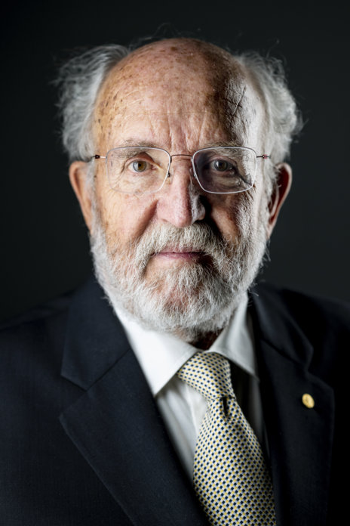
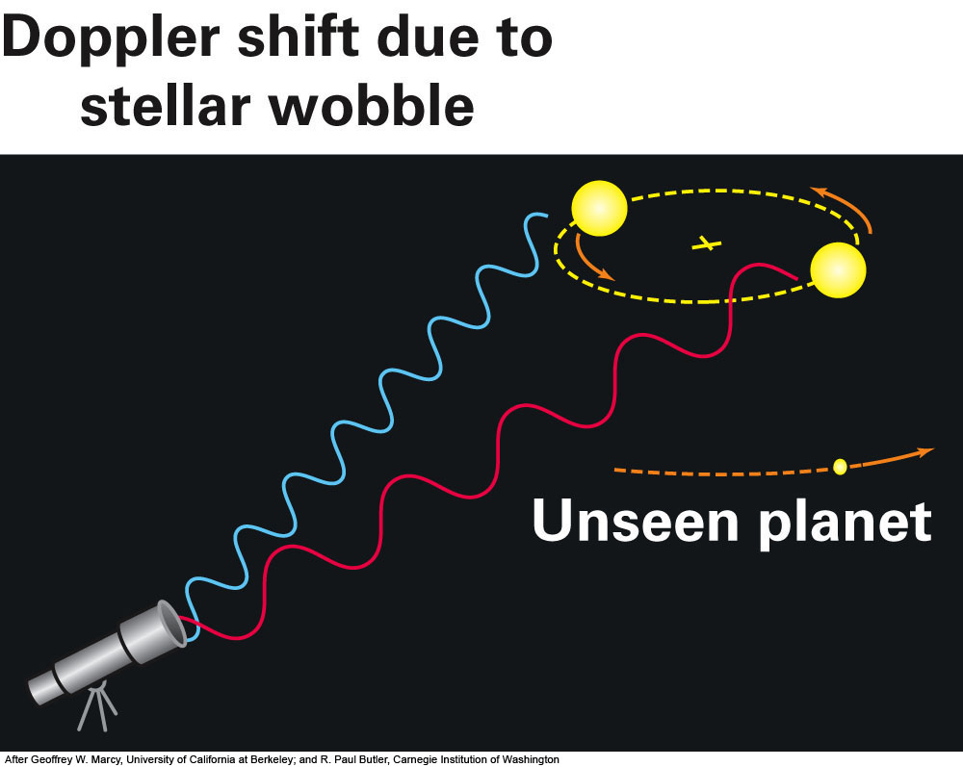
Doppler Shifts: Nobel Prize!
© Gerard Williger 2023, U Louisville
2019 Nobel Prize (Physics) – 1st exoplanet around normal star, both photos © Nobel Media, by A. Mahmoud
Didier Queloz
Michel Mayor
Technique developed in 1990s by Swiss, then US
Use Doppler shifts along line of sight
see periodic change in radial velocity of star
Distance-independent!
Radial Velocity curve - gives PERIOD, also LOWER LIMIT on planet MASS
-- DISTANCE INDEPENDENT!
We can measure Doppler shifts to 30 cm/s (walking speed)
Notes:
First exoplanets were discovered in 1992, around a pulsar. They were considered very unusual because they survived a supernova explosion, or formed after the explosion from the remnant ejecta.

Slide 11
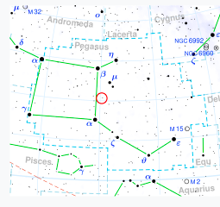
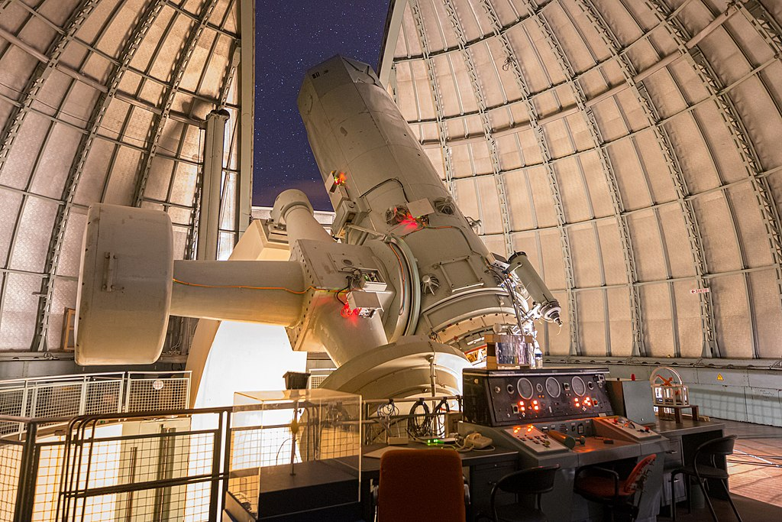
Exoplanet Detection
© Gerard Williger 2023, U Louisville
First Planet detection around a “normal star”: 1995
51 Pegasi B: Mass M = 0.46 M_{Jup},
Period P = 4.2 days
Star’s Mass = 1.1 M⊙ (solar masses)
Distance = 60.6 light yrs (=15.5 parsecs)
Star’s Age = 6.1 billion years - 20% older than Sun
Done by Doppler shift method
Image LINK
1.93m telescope, Obs. de Haute-Provence, France -
Image LINK
51 Peg

Slide 12
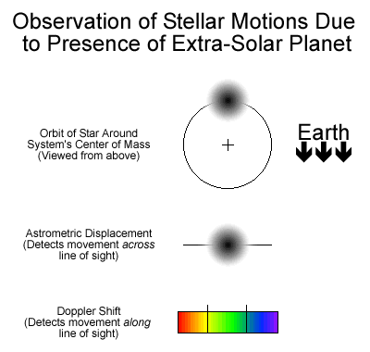
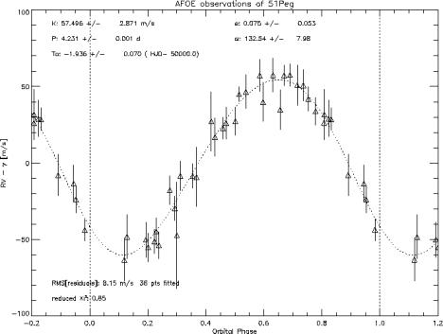
Radial Velocity (and Astrometric) Methods
© Gerard Williger 2023, U Louisville
Radial velocity graph
Earth
Notes:
Astrometric wobbles: hard to measure, angle/wobble decreases with distance

Slide 13
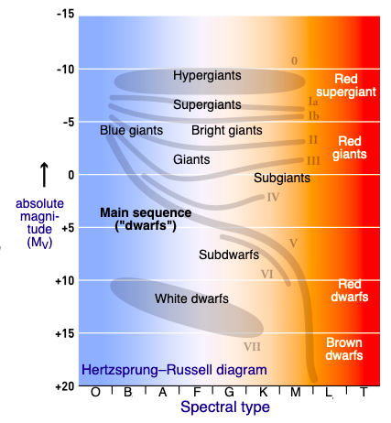
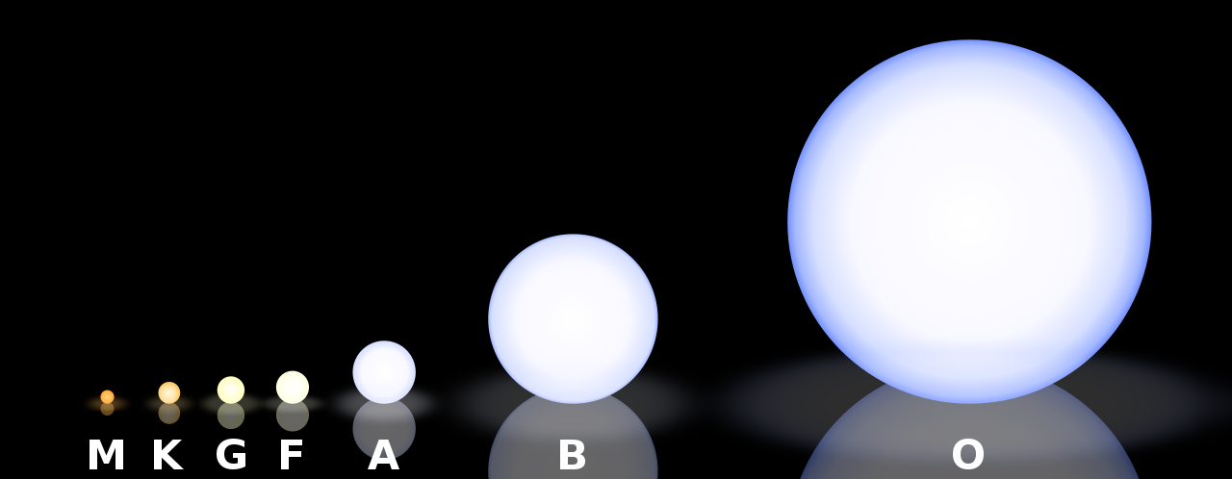
How to know Star Mass?
© Gerard Williger 2023, U Louisville
Star masses known via spectroscopy and a century of study
Star color + star brightness (on photo) + distance (by triangulation or “parallax”) → star size, mass + temperature
add in planet distance from star → planet temperature
Images LINK Wikipedia
BRIGHT
RARE
RARE
SUN
Brightness →
COMMON
FAINT
COOL
HOT
Color →
Main Sequence Diameters
O B A F G K M

Slide 14
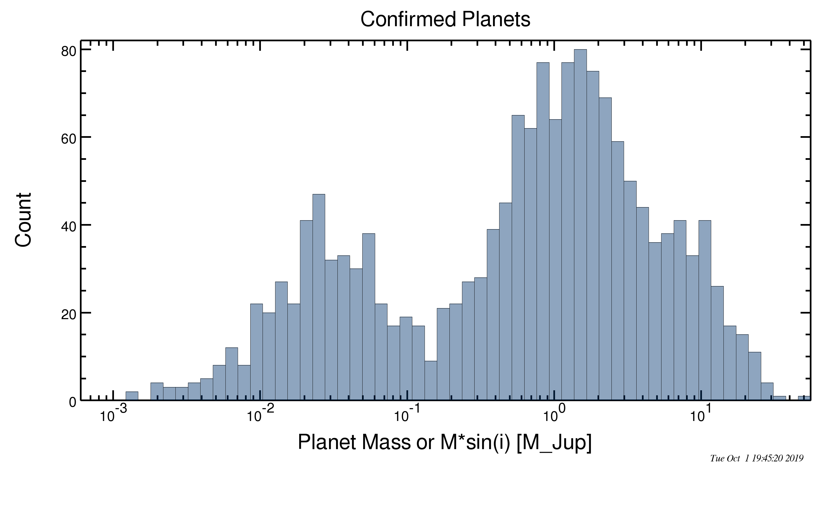
Limitations to Doppler shift Method
© Gerard Williger 2023, U Louisville
angle of the orbit plane unknown
Doppler shift only for motion on sight line – only see projection of orbital motion ◊ only have lower limits to planet masses
Harder to detect low-mass planets
can’t detect systems “pole-on”
Until recently, OBSERVE 1 STAR AT A TIME
Neptune
Saturn
Jupiter
Earth
NASA Exoplanet Database, Oct 2019
Only can measure mass times sin(i)
-- i = inclination angle of planet’s orbit to line of sight
But radial velocities give one more good measurement: planet’s orbital eccentricity.

Slide 15
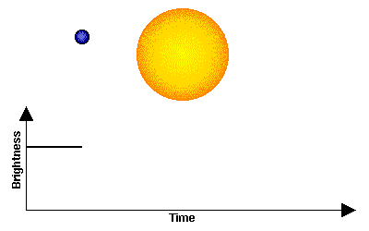
2) Transiting Planets Method
Planet transiting star ◊ dip in star brightness of ~0.01-1%
ex: D_{Jupiter}~0.1D_{Sun}, so A_{Jupiter}/A_{sun}~(0.1)²=0.01 → Jupiter would block out 1% of Sun’s light if aliens watched it transit
-- If we see planet transiting its star → MUST be “edge-on” (inclination i~0 deg)! → Doppler gives true velocity, not projection → get accurate mass
-- Useful: distance-independent + Gives planet PERIOD+SIZE.
-- Limitations: easiest to meature with a large, close-in planet relative to star, perfect alignment
© Gerard Williger 2023, U Louisville
Notes:
CoRoT satellite operated 2006-13, by France + ESA, paved way for Kepler, discovered 32 exoplanets.

Slide 16
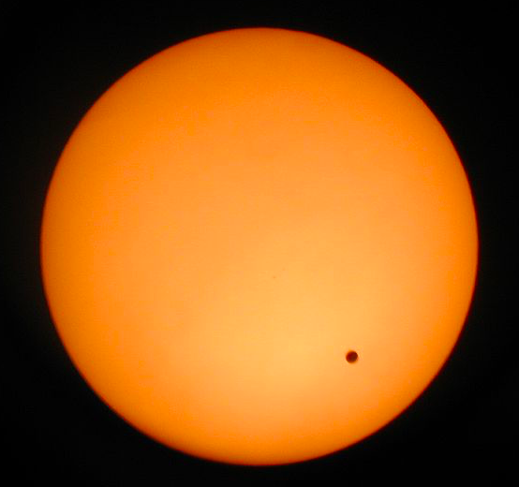
Transits: Precision Measurements
© Gerard Williger 2023, U Louisville
Jupiter is 1/10th = 0.1x size of Sun, covers (1/10)² = 0.01 of Sun’s disk viewed by aliens
→ reduces Sun’s light by 1% during transit
Earth (or Venus) is 0.01x size of Sun, covers 0.0001 of Sun’s disk
→ reduces Sun’s light by 0.01% during transit viewed by aliens
Requires high accuracy
Difficult from ground due to “seeing” (twinkling)
Simulated image
2004 Venus transit, Degania A, Israel
Need to separate out faint companion stars (>80% of candidates) – which can also make transits/eclipses

Slide 17
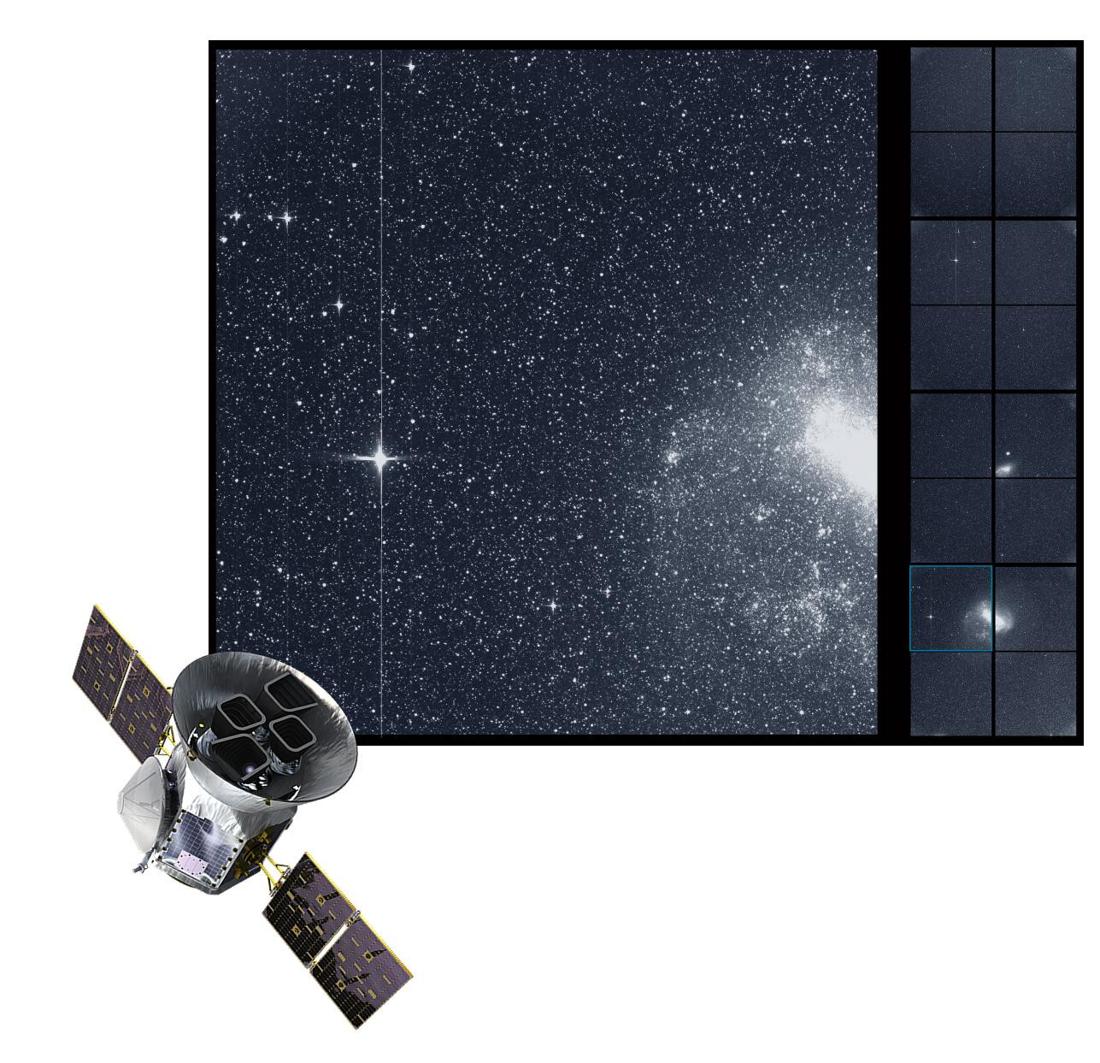
Multiplexing + Key Measures
© Gerard Williger 2023, U Louisville
Transits permit us to monitor MANY stars at once!
1) Detect which stars have planets in front in “edge-on” orbits
2) Measure the planet/star size ratio and orbital period
THEN follow up with spectroscopy for radial velocities
With star mass yields planet: size, mass, density / composition, temperature
NASA Transiting Exoplanet Survey Satellite (TESS, launched 2018) field of view for transit studies. Image provided by J. Kielkopf.
Notes:
We get many details about a planet without directly seeing it!

Slide 18
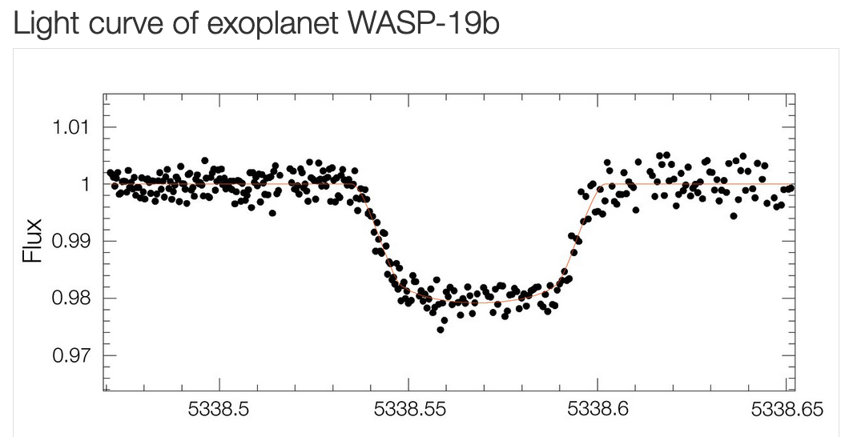
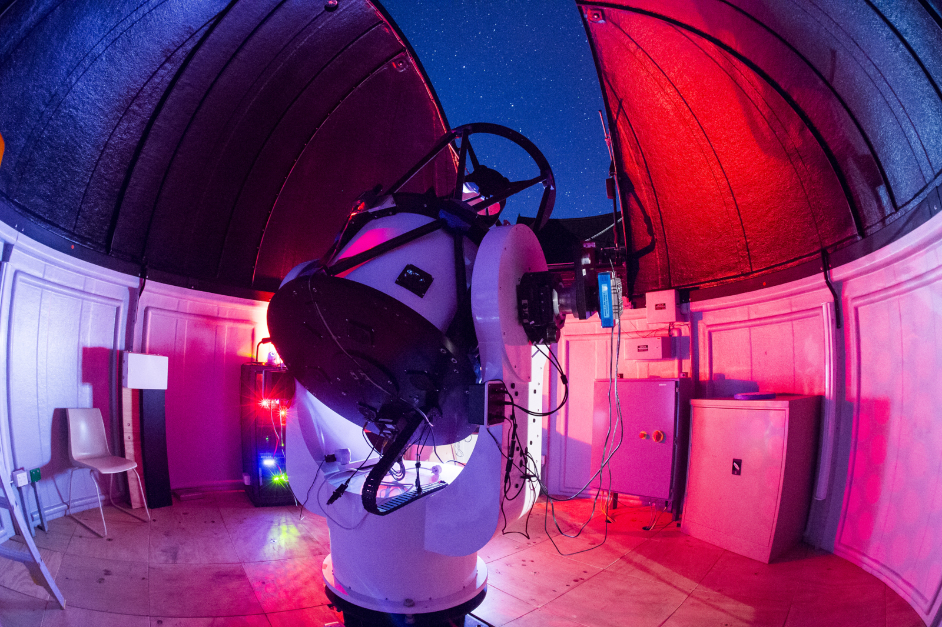
Transits - Ground
© Gerard Williger 2023, U Louisville
1.2 Jupiter masses, P=19 hours, “hot Jupiter”
Dist = 870 LY (267 pc), star = G8 (sun-like)
60cm telescope, Chile
transit of 21 May 2010
Source: ESO
4.3 hours
EXAMPLE PROGRAMS – there are many!
Mt. Kent Obs., U. South Queensland, Australia, 70cm telescope, used for exoplanet transits with U. Louisville
Challenges from ground: (1) twinkling/seeing limit light curve accuracy, (2) miss daytime transits
Observations from ground: Wide Angle Search for Planets (WASP), first transit observed 2000, still operating
Robotic telescope, 8x20cm lenses, Canary Islands, South Africa
Hungarian Automated Telescope network (HATnet)
6 Robotic telescopes, 11-18cm aperture, 1M measurements/night, world-wide, operating since 2001
Notes:
WASP, SuperWASP and HATnet have discovered hundreds of exoplanets through 2023.

Slide 19
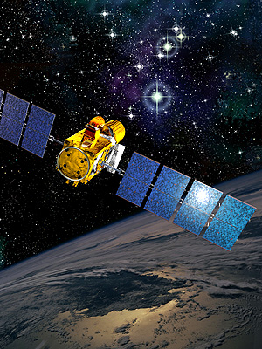
Transits from Space: CoRoT
© Gerard Williger 2023, U Louisville
Advantages using satellite:
No twinkling -- more accurate light curves
No day/night cycle (lose half the time)
Remember: Solar system transits ~6-30 hours (Mercury – Jupiter)
1st transit satellite: Convection, Rotation and planetary Transits
France + ESA, 2006-13
27cm (11”) mirror, 2.7x3 deg field of view (32 Full Moons)
12 “long” fields, 3-6 months each (5000-10000 stars), plus 13 “short” fields, 30 days each
34 planets found, including 1st rocky one
CoRoT, ESA, source LINK
Notes:
So we could lose many transits which happen during “daytime”

Slide 20
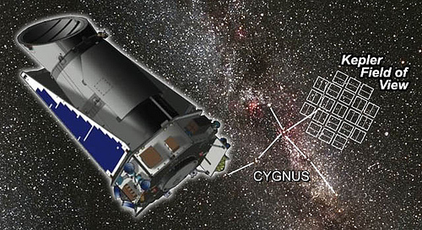
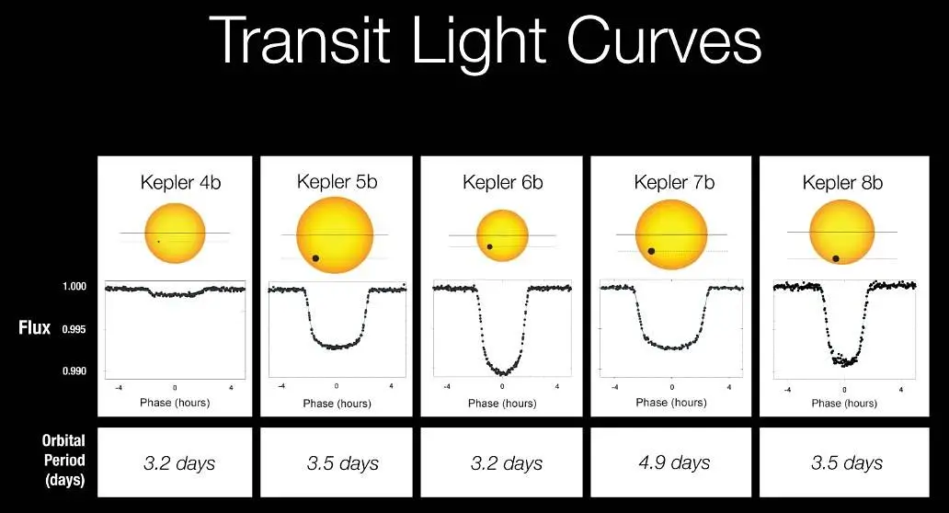
Satellite: Kepler
© Gerard Williger 2023, U Louisville
NASA, 2009-18, 0.95m (1 yard) mirror free aperture
115 deg2 field of view (460 Full Moons), “2 scoops of Big Dipper”
95 Megapix camera
5011 candidates, 2662 confirmed exoplanets
Revolutionized exoplanet research!
Image source LINK
Kepler’s 1st 5 planets. Source LINK

Slide 21
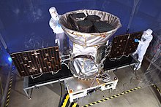
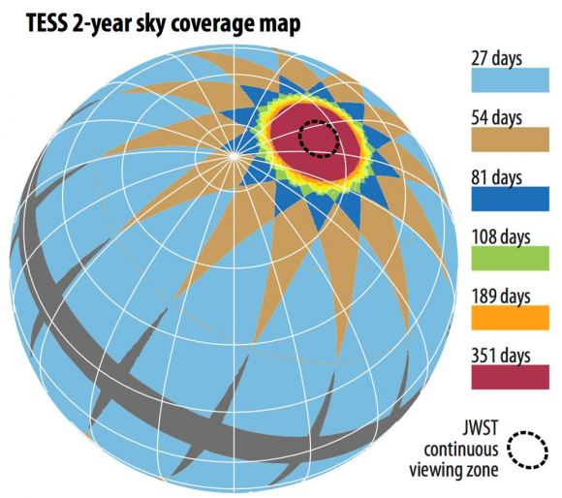
Satellite: TESS
NASA, launched 2018
Transiting Exoplanet Survey Satellite
Images 5% of sky at a time, 8000 Full Moons
Wide field survey of bright stars
Will cover 85% of sky
4 x 10cm telescopes
Trivia: featured in movie Clara (IMDB)
As of 15 Nov 2023, 6977 candidates, 402 confirmed exoplanets (LINK)
Finding targets for James Webb Space Telescope
TESS, pre-launch, image LINK, 1.7’ intro VIDEO, +1.6’ smallest planet VIDEO
Image credit: TESS/MIT
© Gerard Williger 2023, U Louisville

Slide 22
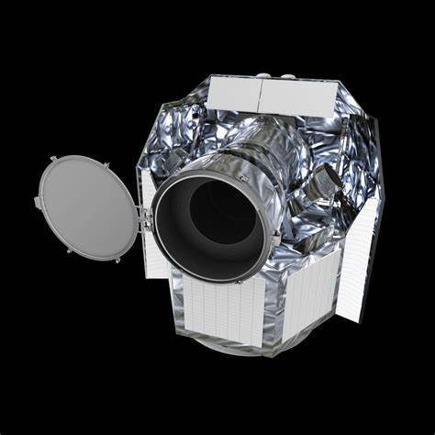
More Satellites
© Gerard Williger 2023, U Louisville
CoRoT – Convection, Rotation and Planetary Transits – France + ESA, 2006-13
Discovered 34 exoplanets
CHEOPS – CHaracterising ExOPlanets Satellite, Swiss + ESA, launched 2019
Follow-up to known exoplanets to measure sizes
Goal: 500 stars with planetary systems
Future: PLATO – PLAnetary Transits and Oscillations of stars, ESA, 2026
Search 1M stars, look for Earth-type planets around sun-like stars
CoRoT, ESA, source LINK
CHEOPS, ESA

Slide 23
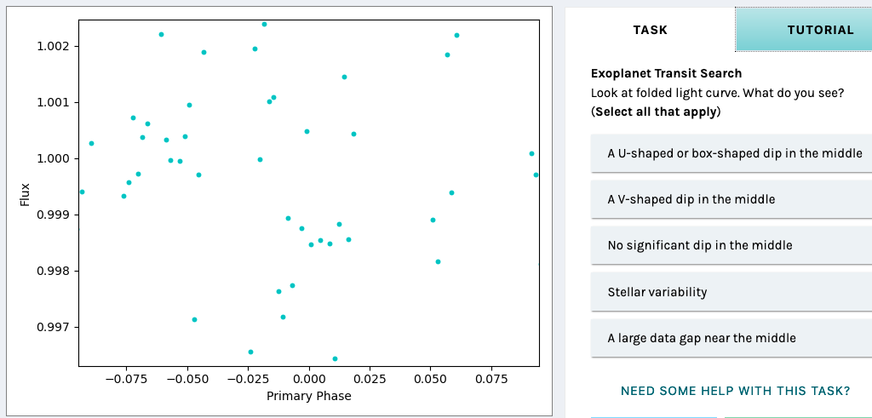
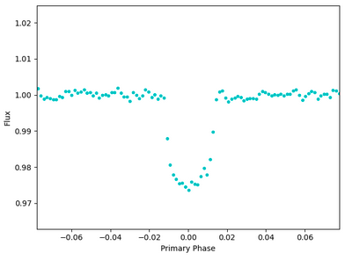
Citizen Science!
© Gerard Williger 2023, U Louisville
Computers identify most exoplanet light curves
Need human touch to find rest!
NASA Exoplanet Citizen Science (“crowdsourcing” clearinghouse)
Some projects “done” ; Active: Exoplanet_Watch
Next Generation Transit Survey (NGTS)
8 x 20cm (8”) Robotic telescopes, hosted by European Southern Obs. (Chile) ; Zooniverse LINK
Usually one sees “noise” (no transit)
Occasionally one sees a transit → exoplanet!
Zooniverse tutorial

Slide 24
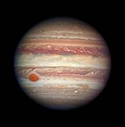
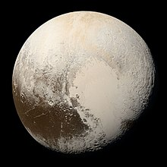
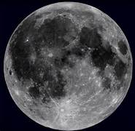
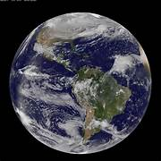
Radial Velocity + Transit → Density
© Gerard Williger 2023, U Louisville
If we know a planet’s mass and size, that gives DENSITY (=mass/volume)
Density ~ 1 g/cc (gram/cubic centimeter) = WATER/ICE or GAS
Density ~2 g/cc = WATER/ICE+ROCK
Density ~3 g/cc = mostly ROCK
Density 4-5 g/cc = ROCK + METAL (typically in core)
All images from NASA
Jupiter
Pluto
Moon
Earth

Slide 25
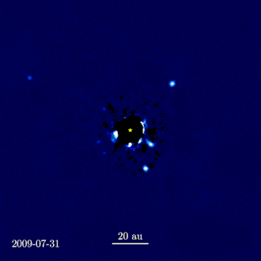
Can We See Exoplanets?
© Gerard Williger 2023, U Louisville
YES! But it’s REALLY HARD
Must block star’s light using “coronagraph” to see faint planets beside it
Best for nearby stars with big planets in distant orbits
Distance Sun - Uranus
Four exoplanets orbiting counterclockwise around star HR 8799. A computer interpolated the movement from –10 still images over 7 years. Image LINK
HR 8799: 1.4 M⊙, 4.9x brighter than Sun, 30 million yrs old, dist = 133 LY (40.1 pc)
PLANETS: 6-9 Jupiter masses; semi-major axes 16-72 AU, Periods 45-460 years

Slide 26
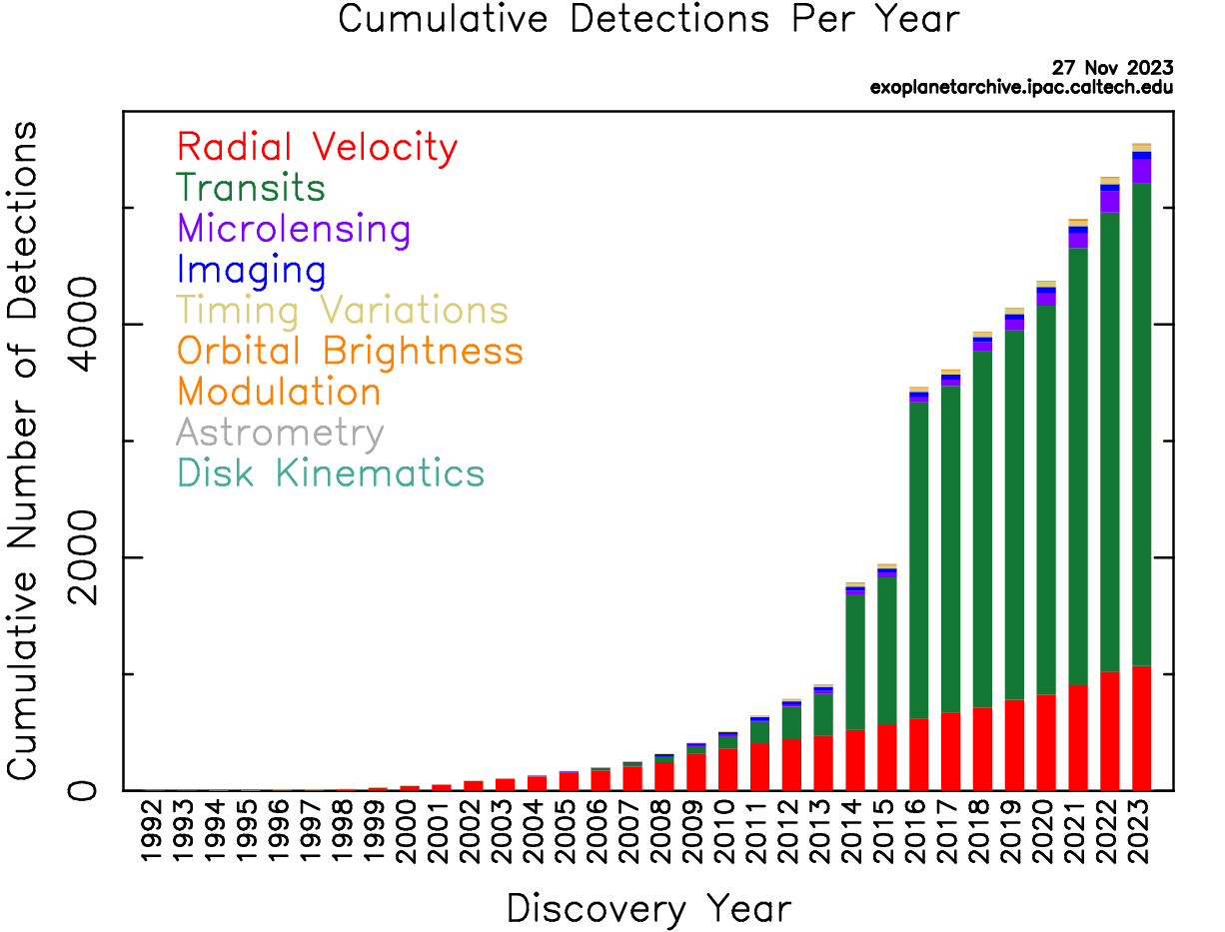
Exoplanet Statistics
© Gerard Williger 2023, U Louisville
Nov 2023: ~5500 exoplanets, even more candidates
http://www.exoplanet.eu/catalog.php
http://exoplanetarchive.ipac.caltech.edu
Main detection methods:
Radial Velocities – first detections
Transits – most discoveries now
← Kepler→
CoRoT
TESS+
CHEOPS
Based on Kepler statistics: BILLIONS of planets in our Milky Way Galaxy – planets are common!

Slide 27
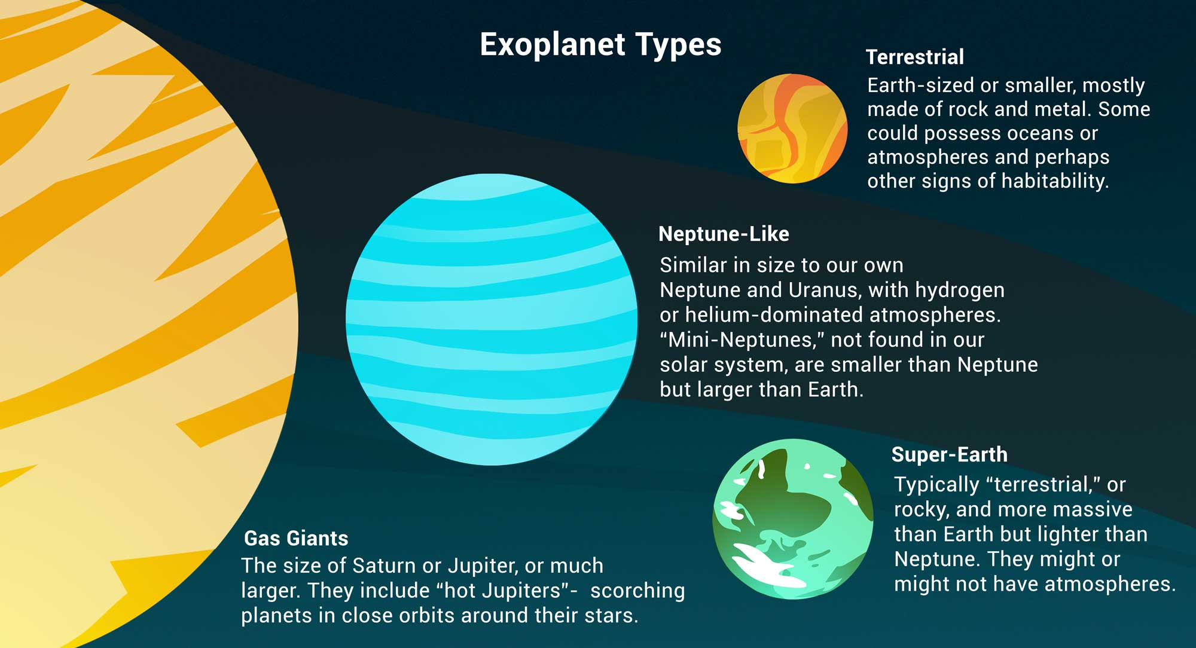
Exoplanet Types: Sizes
© Gerard Williger 2023, U Louisville
We have found a sizes from >10x Jupiter to 2x Moon
FYI 1.7’ VIDEO, overview of planet types, NASA
Image credit: NASA/JPL-Caltech
New size: “Super-Earth” (rocky planet, >1.5 Earth diameter)

Slide 28
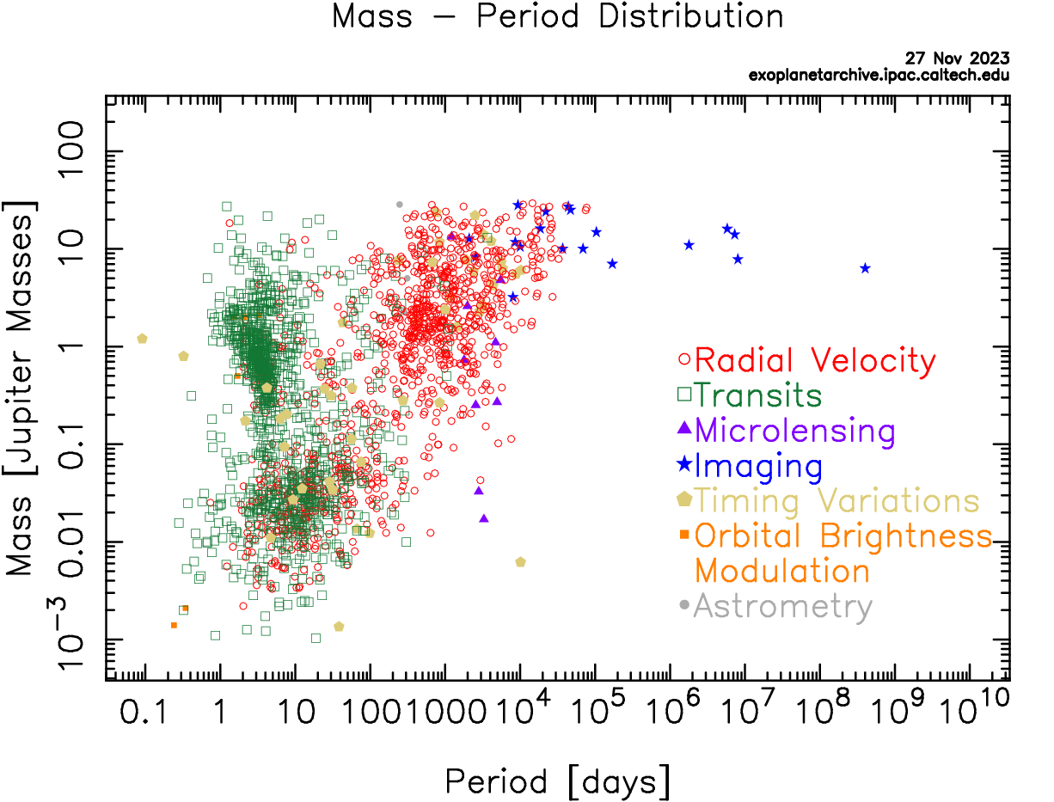
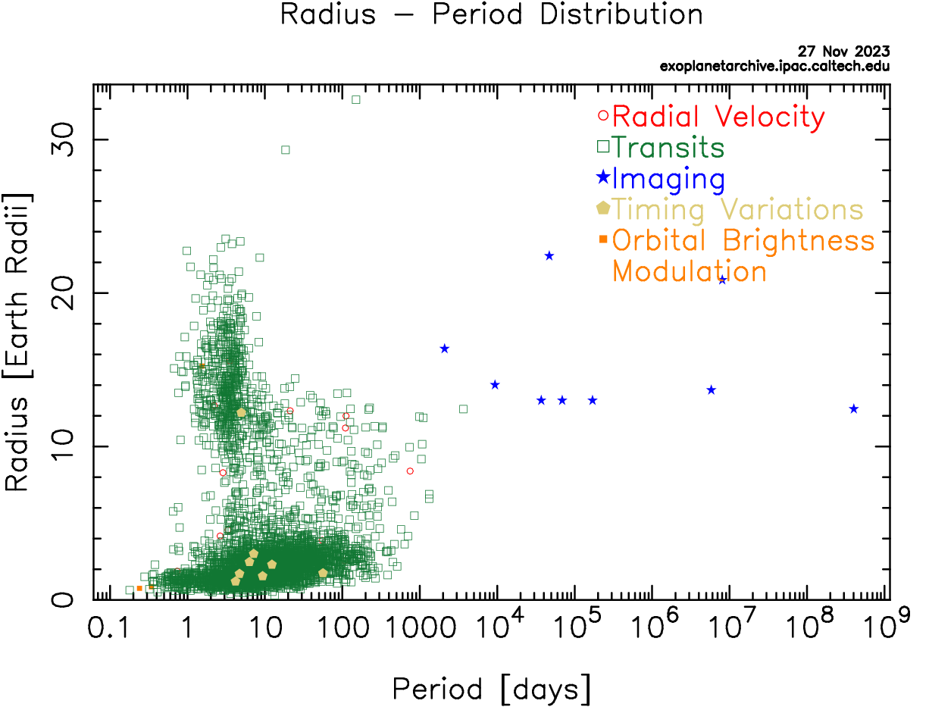
Exoplanets: Mass, Radius, Period
© Gerard Williger 2023, U Louisville
“HOT JUPITERS”
JUPITER
EARTH
From NASA Exoplanet Archive (color-blind plots available)
“HOT JUPITERS”
JUPITER
EARTH

Slide 29
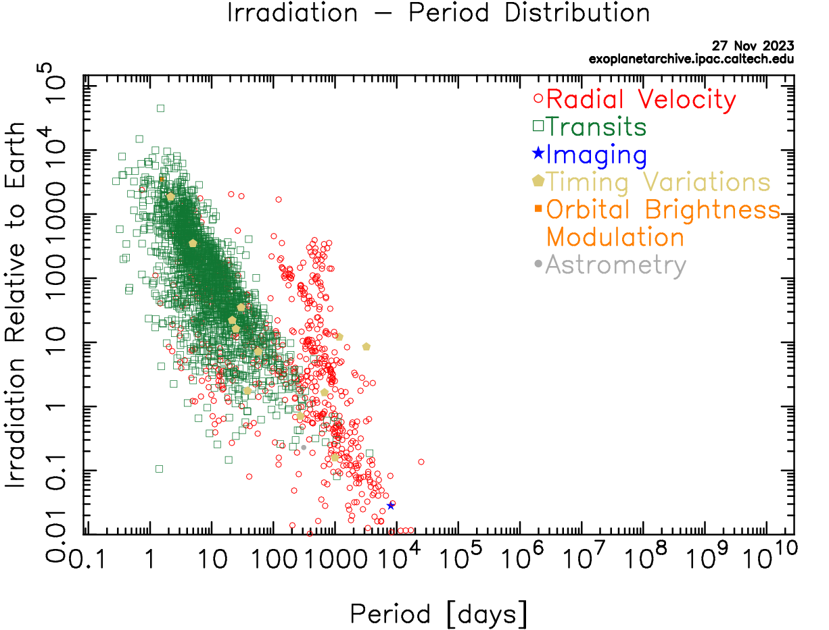
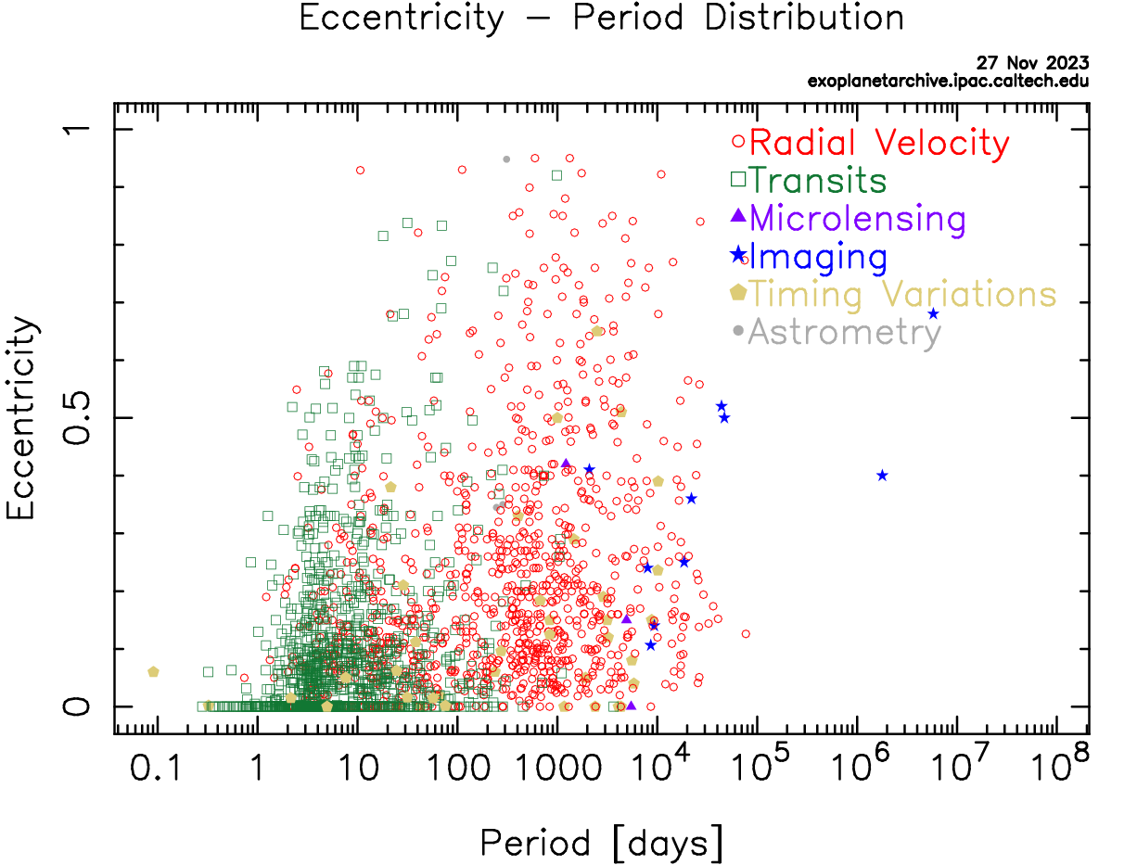
Irradiation/Heat, Eccentricity, Period
© Gerard Williger 2023, U Louisville
Irradiation = sunlight intensity
HOT!
MERCURY
EARTH
JUPITER
From NASA Exoplanet Archive (color-blind plots available)
MERCURY
EARTH
JUPITER

Slide 30
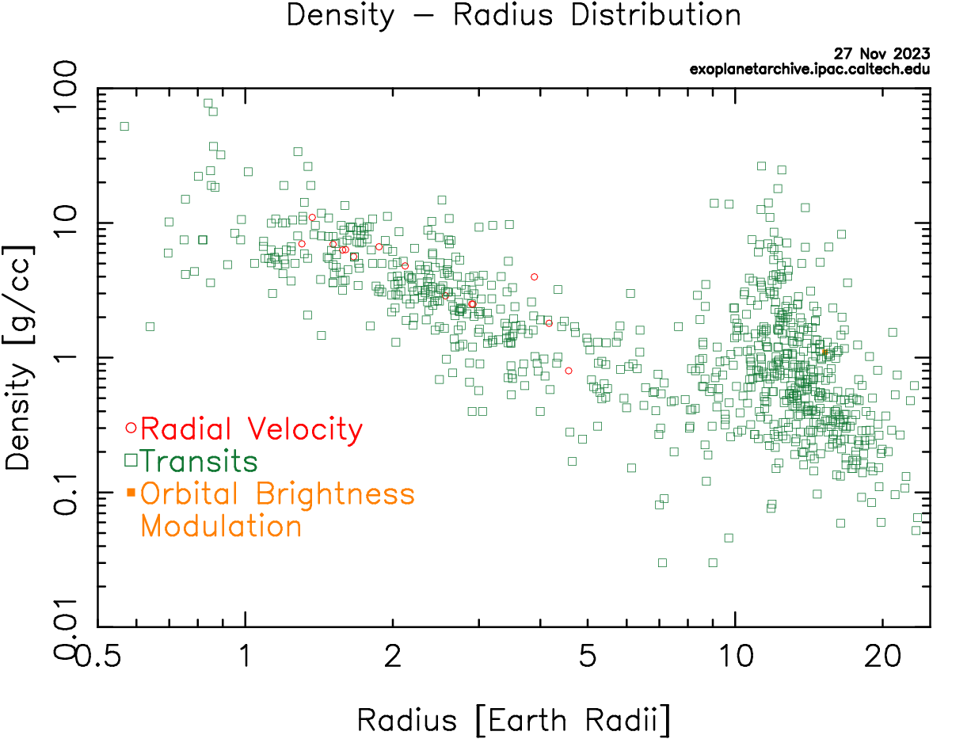
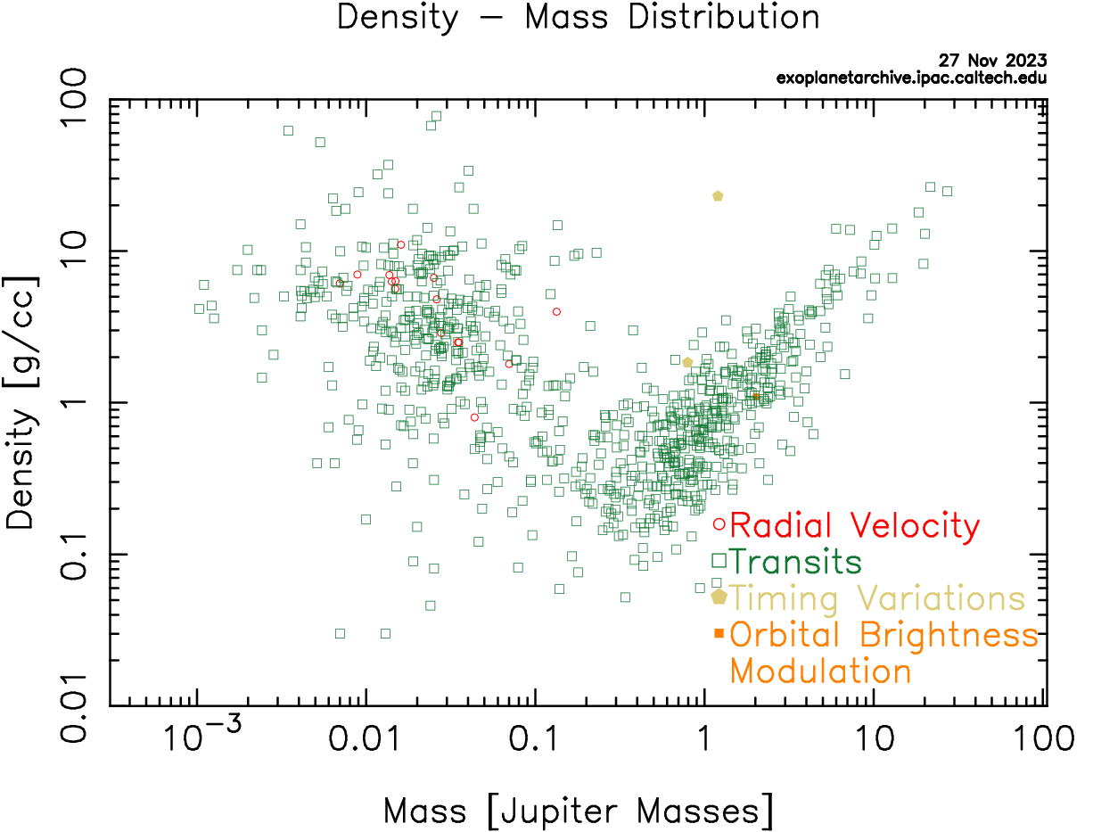
Density, Radius, Mass
© Gerard Williger 2023, U Louisville
EARTH
JUPITER
“FLUFFY” PLANETS
From NASA Exoplanet Archive (color-blind plots available)
EARTH
JUPITER
“FLUFFY” PLANETS

Slide 31
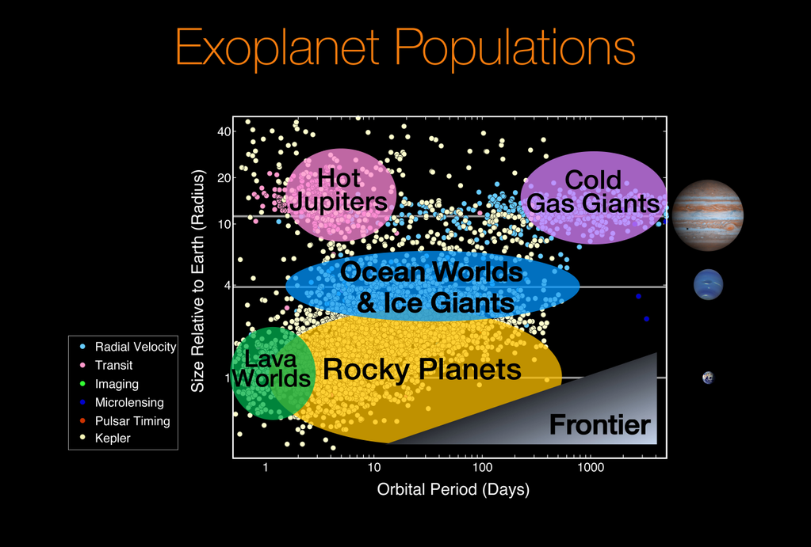
Exoplanet Populations
© Gerard Williger 2023, U Louisville
From NASA Ames Research Center, Natalie Batalha & Wendy Stenzel
TESS results (3’ VIDEO)
Jupiter
Neptune
Super-Earths
Earth
Mars
Mercury

Slide 32
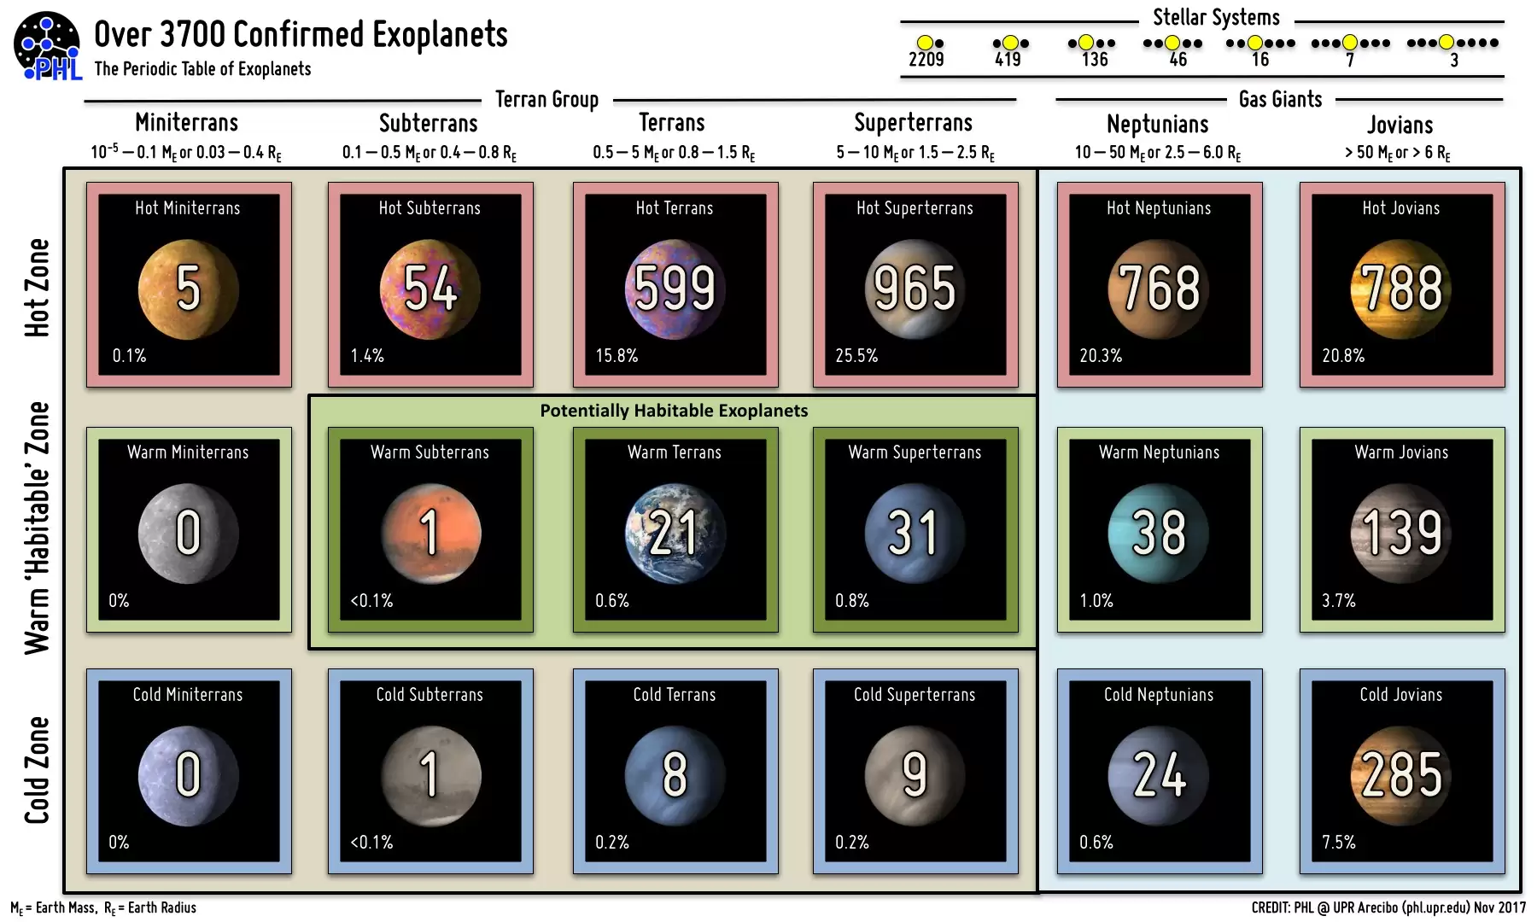
Planet “Periodic Table”
© Gerard Williger 2023, U Louisville
From NASA
“Earths”

Slide 33
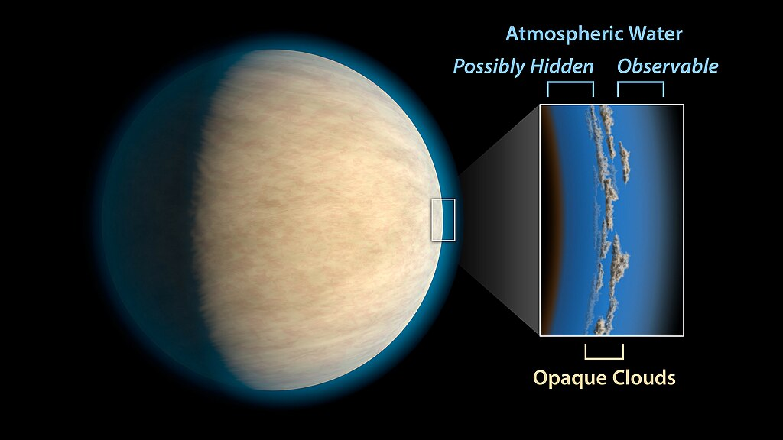

Some New Planet Types
© Gerard Williger 2023, U Louisville
Hot Jupiters: hard to form in place, likely to have “migrated”
Atmospheres eventually ablate, leaving “stripped core” (→ Super-Earth? Ultra-dense?); some hazy atmospheres
Super-Earths: rocky, 1.5-2x Earth
Ocean Worlds: thick atmospheres, big greenhouse effect?
Lava Worlds: rocky, T>1000K (>1400F)
Cotton Candy: large; Styrofoam density
Ultra-dense: dense as iron; “Super-Mercury”; stripped core?
Hot Jupiter with haze layer, ESA/Hubble
Lava world 55 Cancri e, 2x Earth size; dust can stream off with sunlight or solar wind. Artist impression. NASA
Notes:
Super-Earths may retain more heat of formation and be more geologically active.
Lava worlds can be heated by irradiation or tides (if in very eccentric orbits), and have dust streaming off them from stellar wind or radiation pressure.
Cotton candy planets can be young (still forming), with big atmospheres. Some have haze (suspended particles) which prevent
observations of their atmospheric gases.

Slide 34


Exoplanet Atmospheres
© Gerard Williger 2023, U Louisville
Transit provides convenient light source to probe exoplanet’s atmosphere
a
Detections LINK in atmospheres of exoplanets: big variety!
hydrogen, helium, sodium, water, sulfur dioxide, carbon monoxide, CO₂, methane, titanium oxide, hydrogen cyanide
ALSO: clouds, haze, a stratosphere
Image credit: A. Feild, STScI, NASA
Nov 15, 2023
Oxygen? Few cases so far around hot Jupiters, for example in a hot cloud (T=5200K = 10,000F) around a hot Jupiter; also here LINK
James Webb S.T. detection of sand clouds, WASP 107-b, “warm Neptune”, T=770K (932F), dist=200LY. Credit: Michel Min/ESA/NASA

Slide 35


Goldilocks Planets - I
© Gerard Williger 2023, U Louisville
Image LINK, Chester Harman
To support life, (we think we) need:
Solid surface / Earth-sized (0.5 – 2x diameter)?
Temperature to allow liquid water (0-100C at Earth pressure)
Depends on star temperature and distance from star!
Atmospheric greenhouse effect can extend habitable zone.
Goldilocks zone, earthhow.com

Slide 36

Figure 9 from Planetary Candidates Observed by Kepler. III. Batalha et al. 2013 ApJS 204 24
© Gerard Williger 2023, U Louisville
Goldilocks Planets - II
Hot Jupiters
disc. 2010
disc. 2011
disc. 2013
Goldilocks
Super-Earths
Kepler results 2013
Habitable zone
Habitable Exoplanet Catalog: 60 as of Feb 2021

Slide 37

Life on an Exoplanet?
© Gerard Williger 2023, U Louisville
One day, we may find a planet:
Rocky
Earth-sized
Earth-type temperature
Atmosphere with something “out of balance” (which must be replaced)
Example: oxygen
Or perhaps chlorophyll!
May also have magnetic field!
Top ten Earth-like exoplanets, space.com, May 8, 2023, has 2’ VIDEO of exoplanet with magnetic field, YZ Ceti d (not in habitable zone). Also has 22’ VIDEO: Search for another Earth.
Habitable planets as of 2014 – there are many more today! Medium.com, Duncan Geere, Mar 4, 2014

Slide 38

SUMMARY
© Gerard Williger 2023, U Louisville
Perhaps around some exoplanet, there is a large moon which just blocks its star’s disk, permitting a view of its corona and inspiring beings to investigate stars…
Transits allow discovery of LARGE NUMBERS of exoplanets
Also provide:
sizes, probes of atmospheres, densities
orbital periods → semi-major axes → temperatures
Helped by satellites (CoRoT, Kepler, TESS, CHEOPS) and ground-based programs
Result: >5000 exoplanets, BIG VARIETY
Include some “Goldilocks” planets → LIFE????
Numbers only will grow with time as we monitor stars for longer periods
All from science learned from eclipses and transits – what you just saw!
Join in the effort with Citizen Science - STAY TUNED!

